Slide 1
Blockchain-Based Autonomous Notarization System Using National ID Card
Department of CSE
Batch No: 18
Team Members:
217R1A0563 - V. Madhurima
217R1A0538 - N. Kalyan Reddy
217R1A0502 - A. Adarsh Reddy
Under the guidance of
Rakshitha
(Assistant Professor)

Slide 2
Contents
Introduction
Existing System
Disadvantages
Proposed System
Advantages
Hardware and Software Requirements
Novelty of the project
Architecture
Modules
UML Diagrams
Sample code
Results
Conclusion
Future scope
References
Github link

Slide 3
ABSTRACT
The project aims to develop a secure and autonomous notarization system using blockchain technology, leveraging National ID cards for user authentication and document verification.
By integrating blockchain's decentralized ledger with National ID-based digital identification, the system ensures tamper-proof verification, immutability, and transparent record-keeping of notarized documents.
The system automates the notarization process, reducing the need for manual intervention, and provides users with a secure platform for document authentication, ensuring privacy and data integrity.
This approach enhances trust in digital transactions, minimizes fraudulent activities, and streamlines the process of notarization, making it suitable for applications in legal, financial, and government sectors.

Slide 4
Introduction
Integrating national ID cards into the notarization process serves to enhance the reliability of identity verification.
National ID cards are widely recognized and issued by government authorities, providing a standardized means of confirming an individual's identity.
By leveraging this form of identification, the system can ensure that only authorized users can initiate the notarization process, thereby minimizing the risk of identity theft and fraud.
Furthermore, the automated nature of the proposed system allows users to submit documents for notarization without the need for physical visits to notary offices, making the process more accessible and user-friendly.

Slide 5
Existing System
Traditional notary services require physical presence, appointments, and visits to notary offices, leading to delays in document authentication.
The reliance on physical documents and manual verification increases the risk of human error, document tampering, and fraud.
Paper-based documentation and manual methods are prone to risks like document tampering and errors in verification, undermining the overall security of the notarization process.
The absence of standardized procedures across different jurisdictions complicates the process, particularly for cross-border transactions, making it inefficient and inconsistent.

Slide 6
Disadvantages Of existing system
The existing notarization system faces several drawbacks that hinder its efficiency, accessibility, and security:
Physical Presence Requirement: Traditional notarization processes often necessitate the physical presence of individuals at notary public offices, leading to inconvenience and time constraints for users who may need to travel long distances or take time off work to access notary services.
Manual Verification Processes: The reliance on manual verification procedures in traditional notarization introduces the risk of human error, document tampering, and fraud. This can undermine the reliability and credibility of notarized documents.

Slide 7
Proposed system
The proposed Blockchain-Based Autonomous Notarization System (BANS) uses blockchain to store notarized documents in a decentralized, tamper-proof manner, providing an immutable record of notarization.
Verifies user identity through integration with national ID databases, allowing remote authentication and eliminating the need for in-person visits.
Smart contracts automate the verification process, validating documents and registering them on the blockchain without manual intervention.
Offers a secure and user-friendly platform with global access, ensuring data integrity and simplifying cross-border document recognition.
Provides users with the ability to track the status of their document notarization process in real time through a secure online interface, ensuring transparency and reducing uncertainty throughout the process.

Slide 8
Advantages of proposed system
The proposed Blockchain-Based Autonomous Notarization System (BANS) offers several advantages over the existing notarization system:
Accessibility: BANS allows users to initiate the notarization process remotely through a secure web interface, eliminating the need for physical presence at notary public offices. This enhances accessibility for individuals who may face challenges in accessing traditional notary services due to geographical constraints or mobility issues.
Efficiency: By leveraging automation and digitization, BANS streamlines the notarization process, reducing the time and effort required for document authentication. Users can submit documents for notarization quickly and receive digitally signed notarization certificates promptly, accelerating transaction processing times.

Slide 9
HarDware and software requirements
HARDWARE REQUIREMENTS :
System : intel i5
Ram : 4GB Ram
Hard disk : 40GB
SOFTWARE REQUIREMENTS :
Operating system : Windows 11
Coding Language : python 3.7.0

Slide 10
Novelty of the project
This project introduces a novel approach to notarization by seamlessly integrating blockchain technology with national ID verification, creating a secure, efficient, and accessible system.
Decentralized
Secure
Efficient
Accessible

Slide 11
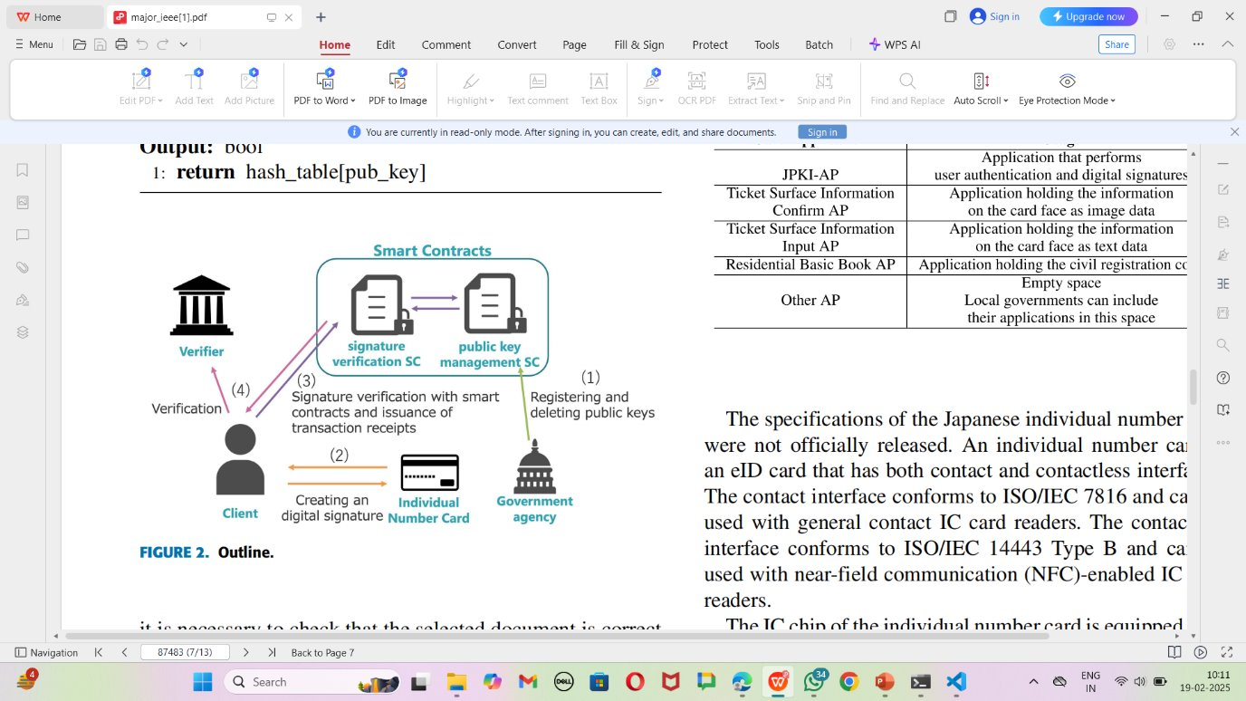
System Architecture

Slide 12
modules
Verifier Login: Verifier can login to system using username and password as admin.
New User Sign up: New users can sign up with application and details will get saved in blockchain.
User Login: User can login with sign up details and after user will perform below operations.
Add Notary: User can create notary using pin no and e ID file.
Delete Notary: User can delete any existing notary details and keys.
View Notary: using this module user can view notary on particular eID and pin no.

Slide 13
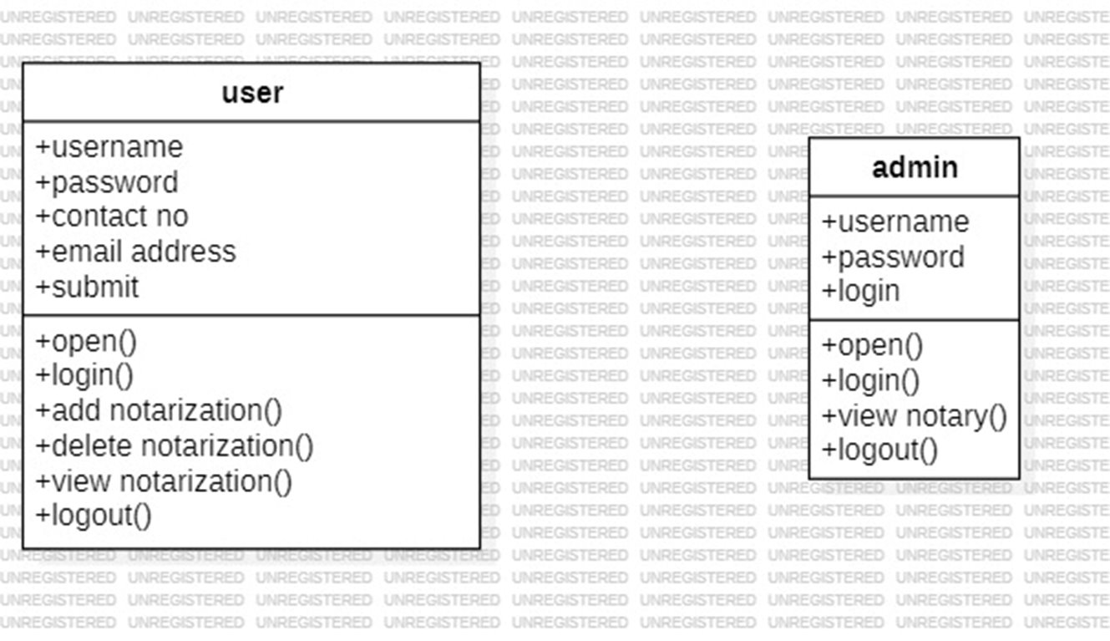
Uml diagrams
CLASS DIAGRAM :​

Slide 14
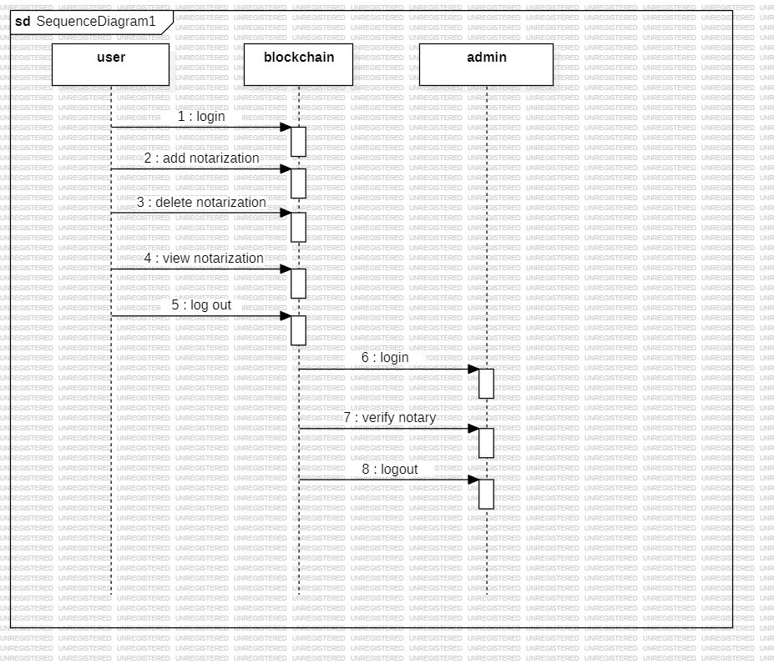
SEQUENCE DIAGRAM:​

Slide 15
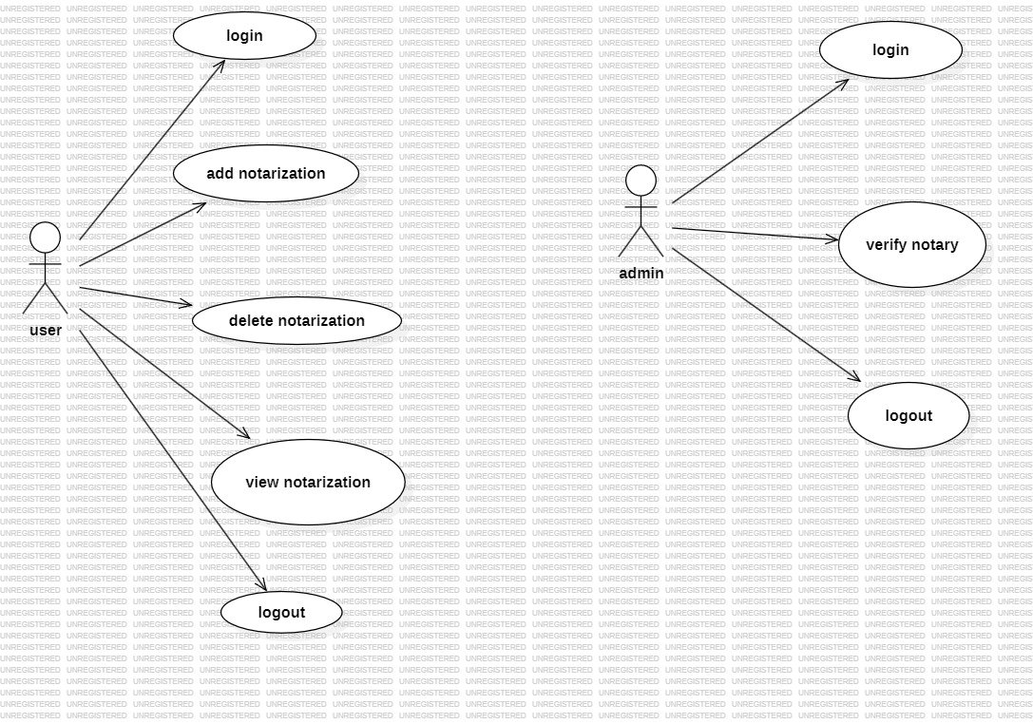
USECASE DIAGRAM :​

Slide 16
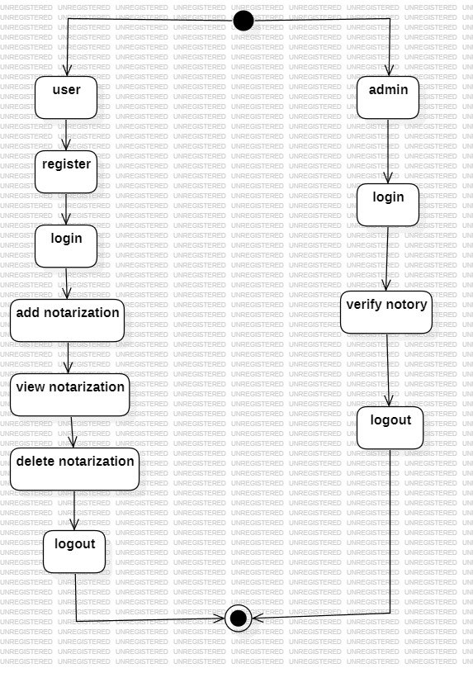
ACTIVITY DIAGRAM :​

Slide 17
Sample code
from django.shortcuts import render
from django.template import RequestContext
from django.contrib import messages
from django.http import HttpResponse
from django.core.files.storage import FileSystemStorage
import os
from datetime import date
import json
from web3 import Web3, HTTPProvider
import hashlib
global username, usersList, notaryList, contract, web3
#function to call contract
def getContract():
global contract, web3
blockchain_address = 'http://127.0.0.1:9545'
web3 = Web3(HTTPProvider(blockchain_address))
web3.eth.defaultAccount = web3.eth.accounts[0]

Slide 18
compiled_contract_path = 'Notary.json' #Logistic contract file
deployed_contract_address = '0xb1fe285e049D8C29bec9Fb178AE8A6eFc5202085' #contract address
with open(compiled_contract_path) as file:
contract_json = json.load(file) # load contract info as JSON
contract_abi = contract_json['abi'] # fetch contract's abi - necessary to call its functions
file.close()
contract = web3.eth.contract(address=deployed_contract_address, abi=contract_abi)
getContract()
compiled_contract_path = 'Notary.json' #Logistic contract file
deployed_contract_address = '0xb1fe285e049D8C29bec9Fb178AE8A6eFc5202085' #contract address
with open(compiled_contract_path) as file:
contract_json = json.load(file) # load contract info as JSON
contract_abi = contract_json['abi'] # fetch contract's abi - necessary to call its functions
file.close()
contract = web3.eth.contract(address=deployed_contract_address, abi=contract_abi)
getContract()
def getUsersList():
global usersList, contract
usersList = []

Slide 19
count = contract.functions.getUserCount().call()
for i in range(0, count):
user = contract.functions.getUsername(i).call()
password = contract.functions.getPassword(i).call()
phone = contract.functions.getPhone(i).call()
email = contract.functions.getEmail(i).call()
address = contract.functions.getAddress(i).call()
usersList.append([user, password, phone, email, address])
def getNotary():
global notaryList, contract
notaryList = []
count = contract.functions.getNotaryCount().call()
for i in range(0, count):
uname = contract.functions.getOwner(i).call()
fname = contract.functions.getFilename(i).call()
hashcode = contract.functions.getHashcode(i).call()
dd = contract.functions.getDate(i).call()
signature = contract.functions.getSignature(i).call()

Slide 20
key = contract.functions.getKey(i).call()
notaryList.append([uname, fname, hashcode, signature, dd, key])
getUsersList()
getNotary()
def VerifyNotaryAction(request):
if request.method == 'POST':
global username, notaryList
today = date.today()
pin = request.POST.get('t1', False)
filedata = request.FILES['t2'].read()
filename = request.FILES['t2'].name
hashcode = hashlib.sha256(filedata).hexdigest()
key = hashlib.sha256(pin.encode()).hexdigest()
status = "Verification Failed"
for i in range(len(notaryList)):
nl = notaryList[i]
if nl[2] == hashcode and nl[5] == key:
status = nl

Slide 21
break
if status != "Verification Failed":
output = '<table border=1 align=center>'
output+='<tr><th><font size=3 color=black>Owner Name</font></th>'
output+='<th><font size=3 color=black>eID File Name</font></th>'
output+='<th><font size=3 color=black>Hashcode</font></th>'
output+='<th><font size=3 color=black>Signature</font></th>'
output+='<th><font size=3 color=black>Date</font></th>'
output+='<th><font size=3 color=black>Key</font></th></tr>'
arr = status[3].split("$")
output+='<tr><td><font size=3 color=black>'+status[0]+'</font></td>'
output+='<td><font size=3 color=black>'+status[1]+'</font></td>'
output+='<td><font size=3 color=black>'+status[2][0:20]+'</font></td>'
output+='<td><font size=3 color=black>'+arr[0]+'</font></td>'
output+='<td><font size=3 color=black>'+status[4]+'</font></td>'
output+='<td><font size=3 color=black>'+status[5][0:20]+'</font></td></tr>'
output+='<tr><td><font size=3 color=black>Notary Text : '+arr[1]+'</font></

Slide 22
td></tr>'
status = output
context= {'data': status}
return render(request, 'VerifierScreen.html', context)
def VerifyNotary(request):
if request.method == 'GET':
return render(request, 'VerifyNotary.html', {})
def AddNotary(request):
if request.method == 'GET':
return render(request, 'AddNotary.html', {})
def AddNotaryAction(request):
if request.method == 'POST':
global username, notaryList
today = date.today()
notary = request.POST.get('t1', False)
pin = request.POST.get('t2', False)
filedata = request.FILES['t3'].read()
filename = request.FILES['t3'].name

Slide 23
hashcode = hashlib.sha256(filedata).hexdigest()
key = hashlib.sha256(pin.encode()).hexdigest()
status = "none"
for i in range(len(notaryList)):
nl = notaryList[i]
if nl[2] == hashcode:
status = "Your eID Card Alread exists"
break
if status == "none":
msg = contract.functions.RegisterHash(username, filename, hashcode, pin+"$"+notary, str(today), key).transact()
tx_receipt = web3.eth.waitForTransactionReceipt(msg)
notaryList.append([username, filename, hashcode, pin+"$"+notary, str(today), key])
status = "Your notary details successfully saved in Blockchain using below details<br/>"+str(tx_receipt)
else:
status = "Error in saving Notary details"
context= {'data': status}
return render(request, 'AddNotary.html', context)

Slide 24
def DeleteNotaryAction(request):
if request.method == 'GET':
global uname, contract, notaryList
rid = request.GET['file']
contract.functions.deleteKey(int(rid)).transact()
nl = notaryList[int(rid)]
nl[2] = "Delete"
context= {'data': "Given notary key deleted from Blockchain"}
return render(request, 'UserScreen.html', context)
def ViewNotary(request):
if request.method == 'GET':
global contract, notaryList, username
output = '<table border=1 align=center>'
output+='<tr><th><font size=3 color=black>Owner Name</font></th>'
output+='<th><font size=3 color=black>eID File Name</font></th>'
output+='<th><font size=3 color=black>Hashcode</font></th>'

Slide 25
output+='<th><font size=3 color=black>Signature</font></th>'
output+='<th><font size=3 color=black>Date</font></th>'
output+='<th><font size=3 color=black>Key</font></th></tr>'
for i in range(len(notaryList)):
nl = notaryList[i]
if nl[0] == username:
arr = nl[3].split("$")
output+='<tr><td><font size=3 color=black>'+nl[0]+'</font></td>'
output+='<td><font size=3 color=black>'+nl[1]+'</font></td>'
output+='<td><font size=3 color=black>'+nl[2][0:20]+'</font></td>'
output+='<td><font size=3 color=black>'+arr[0]+'</font></td>'
output+='<td><font size=3 color=black>'+nl[4]+'</font></td>'
output+='<td><font size=3 color=black>'+nl[5][0:20]+'</font></td></tr>'
output+='<tr><td><font size=3 color=black>Notary Text : '+arr[1]+'</font></td></tr>'
context= {'data': output}
return render(request, 'UserScreen.html', context)
def DeleteNotary(request):
if request.method == 'GET':

Slide 26
def LoginAction(request):
if request.method == 'POST':
global username, usersList
username = request.POST.get('t1', False)
password = request.POST.get('t2', False)
status = 'none'
for i in range(len(usersList)):
ul = usersList[i]
if ul[0] == username and ul[1] == password:
status = 'success'
break
if status == 'success':
context= {'data':"Welcome "+username}
return render(request, 'UserScreen.html', context)
else:
context= {'data':'Invalid login details'}
return render(request, 'Login.html', context)

Slide 27
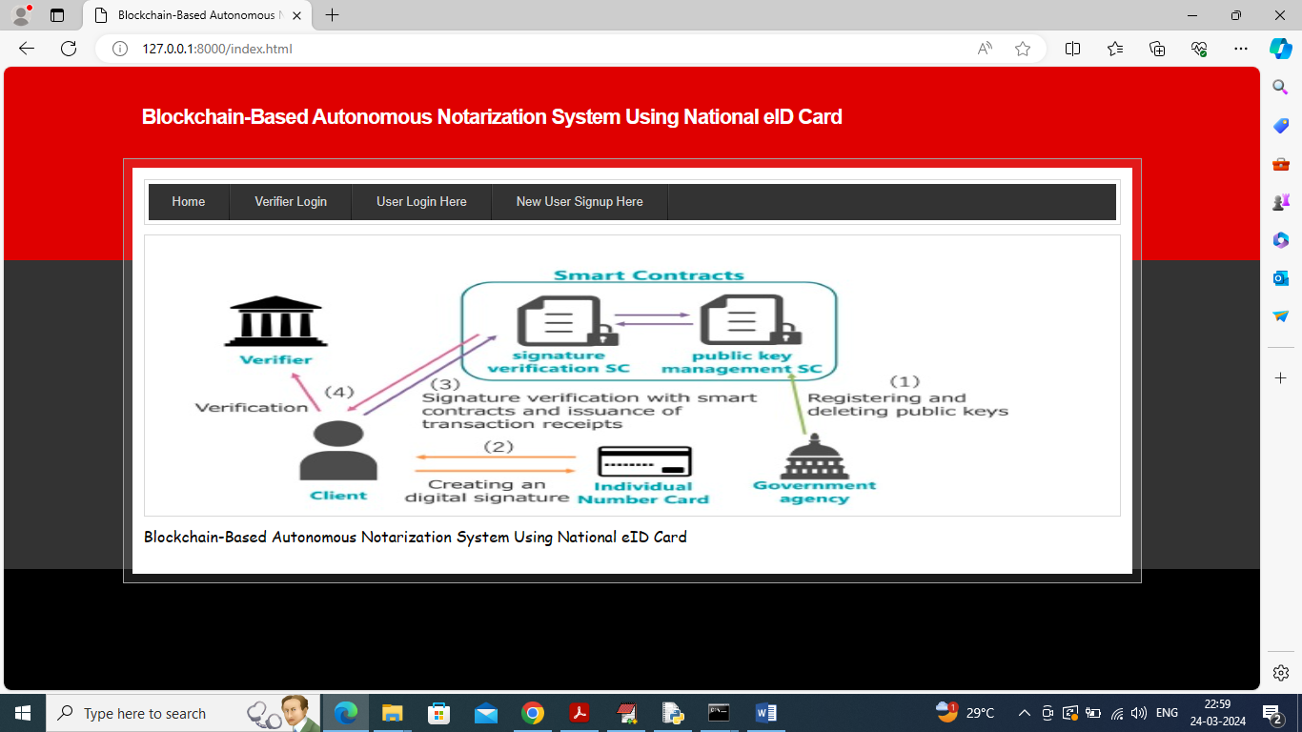
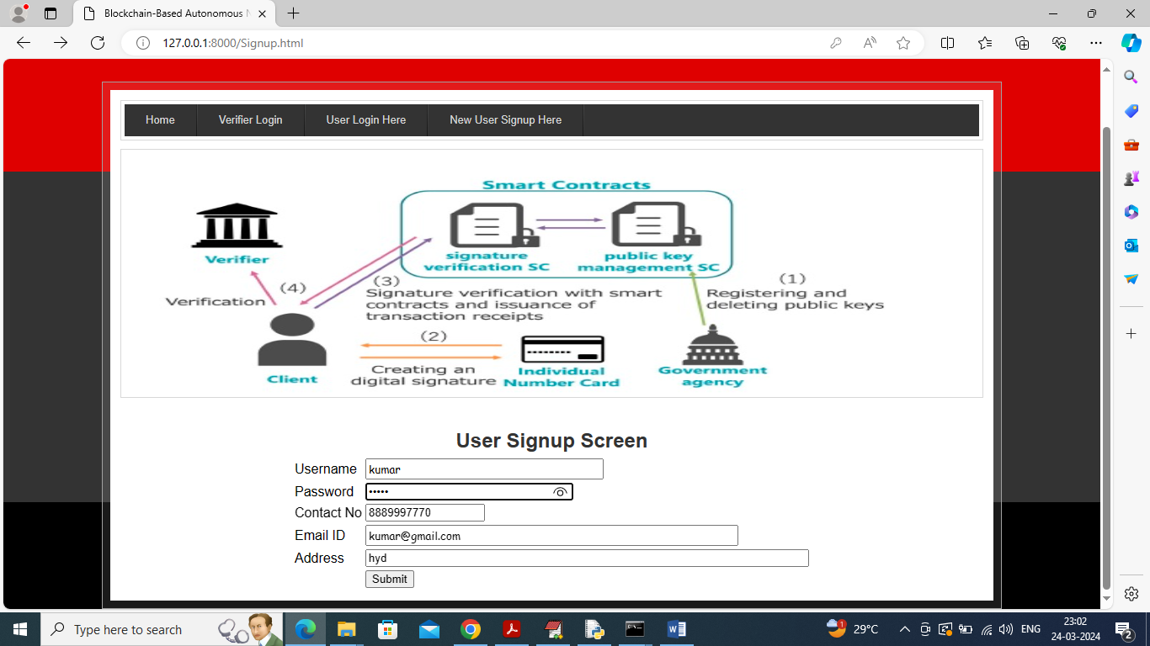
results

Slide 28
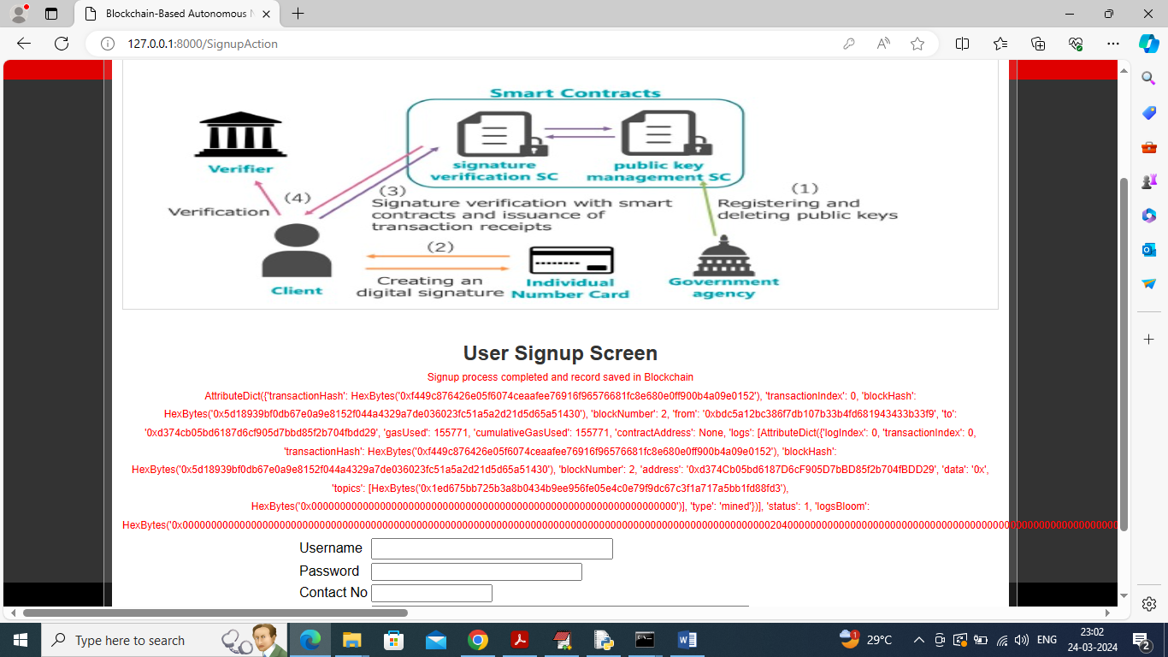
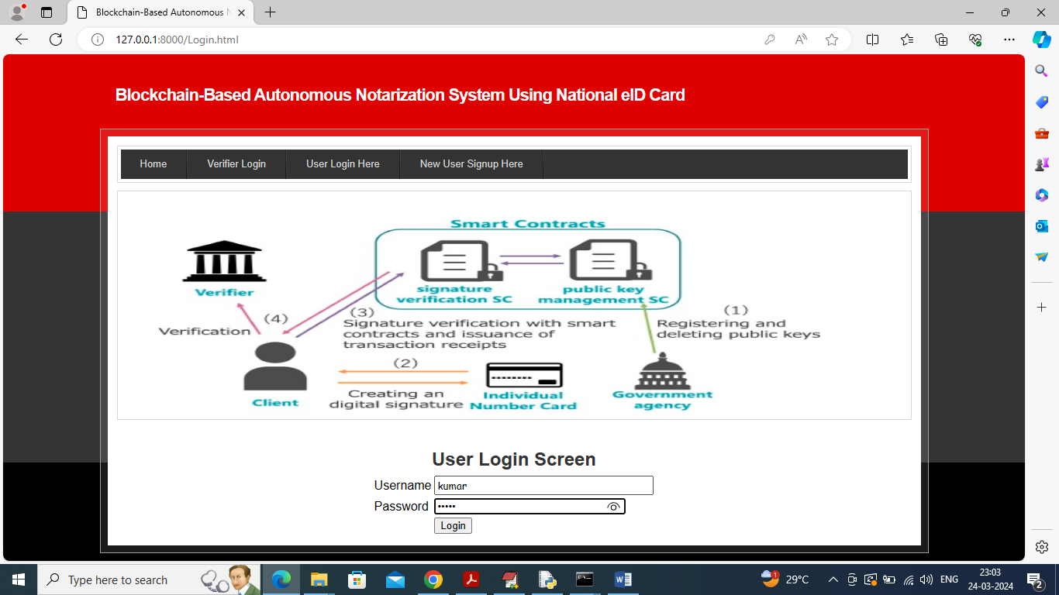

Slide 29
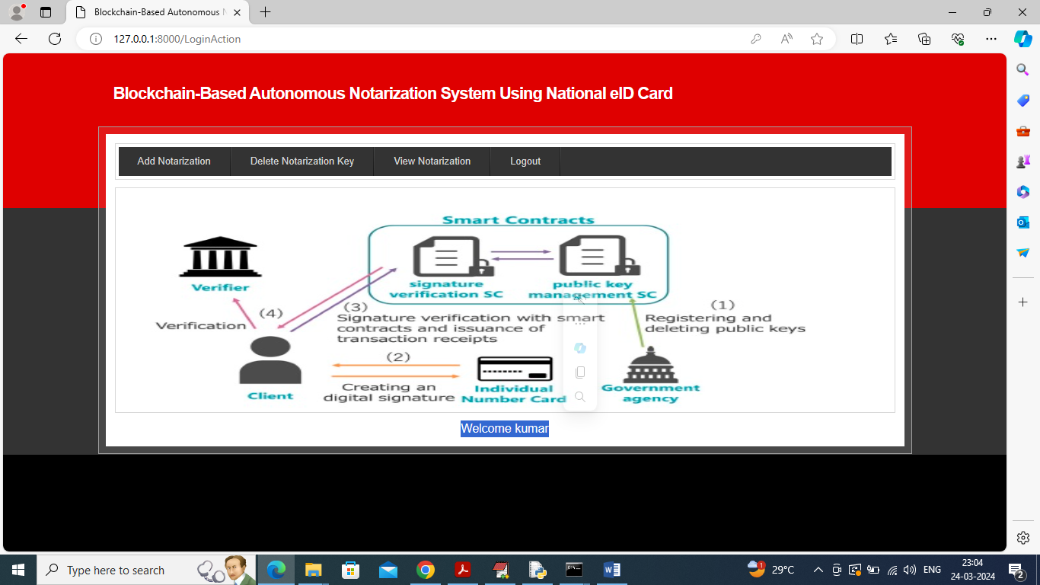
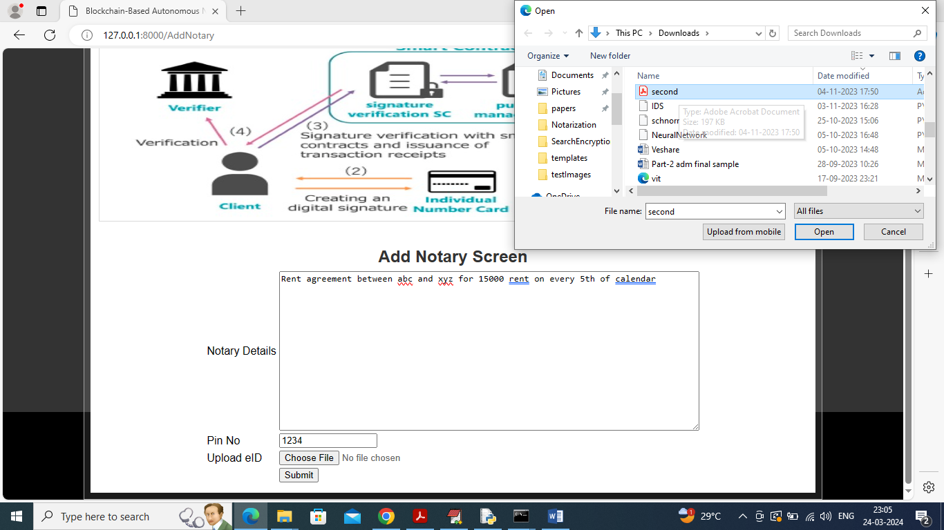

Slide 30
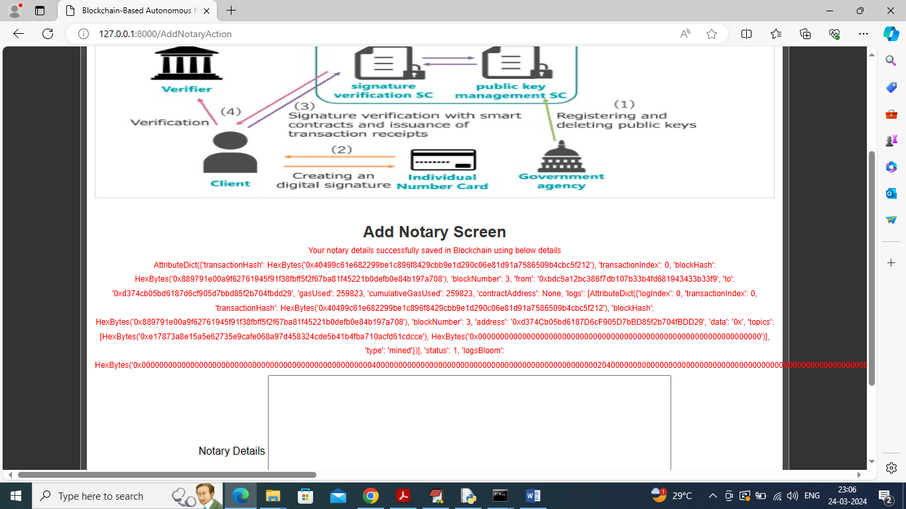
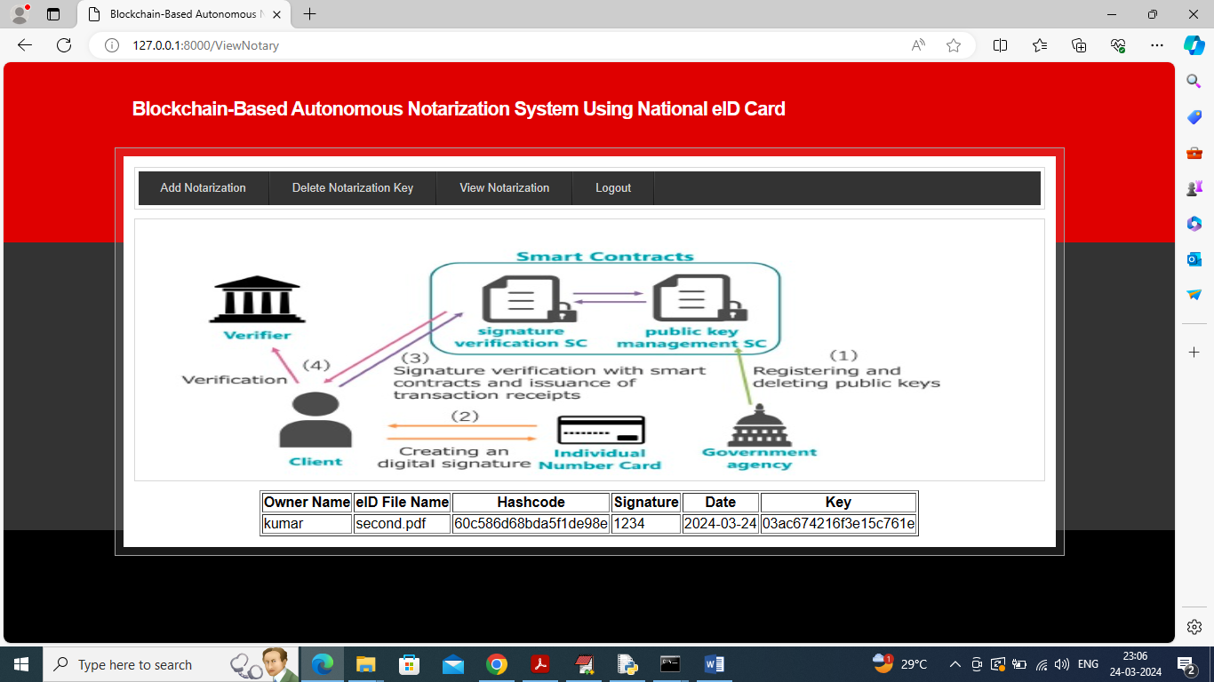

Slide 31



Slide 32
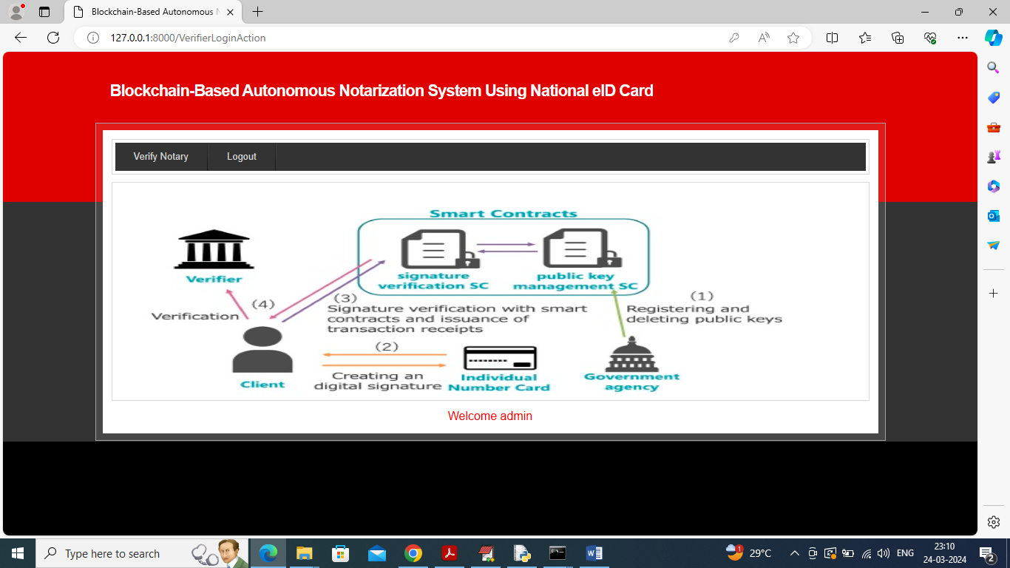
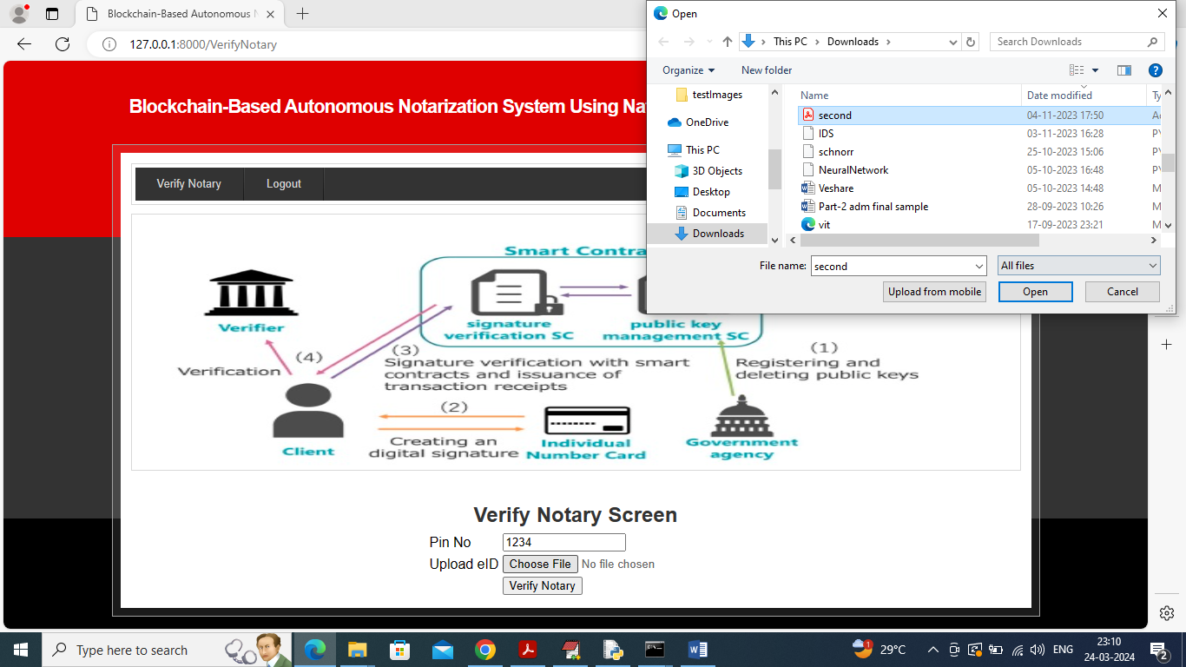

Slide 33



Slide 34


Slide 35
conclusion
The proposed blockchain-based autonomous notarization system using national ID cards offers a significant improvement over traditional methods, providing a secure, efficient, and accessible solution for document verification.
It combines the security of blockchain technology with the reliability of national identity verification, making it a robust option for individuals and businesses alike .
The system can be applied to a wide range of scenarios, including legal contracts, property transactions, and identity verification.
The widespread adoption of this system can revolutionize document verification processes worldwide, promoting trust, efficiency, and security.

Slide 36
FUTure scope
Artificial Intelligence and Machine Learning
Document Analysis: Implement AI and machine learning algorithms to analyze and categorize documents, improving the accuracy and efficiency of the notarization process.
Fraud Detection: Use AI to detect and prevent fraudulent activities by analyzing patterns and anomalies in notarization data.
Continuous Security Monitoring
Threat Intelligence: Develop systems for real time threat intelligence and adaptive security measures to protect against emerging threats.
User Education and Support
Training Programs: Develop training programs and resources to educate users about the benefits and use of blockchain based notarization.
Support Services: Enhance customer support services to assist users with technical issues and inquiries.

Slide 37
references
Swan, M. (2015). Blockchain Basics: A Non Technical Introduction in 25 Steps. Apress.
Tapscott, D., & Tapscott, A. (2016). Blockchain Revolution: How the Technology Behind Bitcoin Is Changing Money, Business, and the World. Penguin Books.
Risius, M., & Spohrer, K. (2017). "A Blockchain Research Framework."Business & Information Systems Engineering, 59(6), 385 409.
Murray, A. (2018). Blockchain for Dummies. John Wiley & Sons.
Hsieh, Y., & Zheng, Z. (2020). "Blockchain Technology in the Financial Industry: A Review and Future Directions."Journal of Financial Technology, 1(1), 1 23.

Slide 38
Github Link
https://github.com/batch18/major-project-blockchain-based-autonomous-notarization-system -using–national-eId- card

Slide 39
Thank you
Batch No:18
CSE-A

